Slide 1
Smart Seat & Luggage Management System
Presented by – Satarupa Bhowmik , Debarshi Sau , Aryan Gupta

Slide 2
Problem Statement -
In the current railway system, luggage storage inside coaches is unstructured and unmanaged. Although seats are digitally allocated, no fixed luggage slot is assigned to passengers. This results in random luggage placement, overcrowded racks, and frequent conflicts among passengers. The absence of a monitoring system leads to poor space utilization and reduced travel comfort.
Key points:-
No fixed luggage slot allocation Random luggage placement Passenger conflicts No tracking system Poor space utilization

Slide 3
As-Is vs To-Be Process Map
The existing (As-Is) railway process assigns seats but does not manage luggage storage. Passengers place luggage randomly, leading to disputes and inefficient space usage. In the proposed (To-Be) system, every seat is mapped to a specific luggage slot. QR codes are generated for verification, and extra luggage requires pre-booking or fine payment. This ensures transparency, fairness, and better organization.

Slide 4
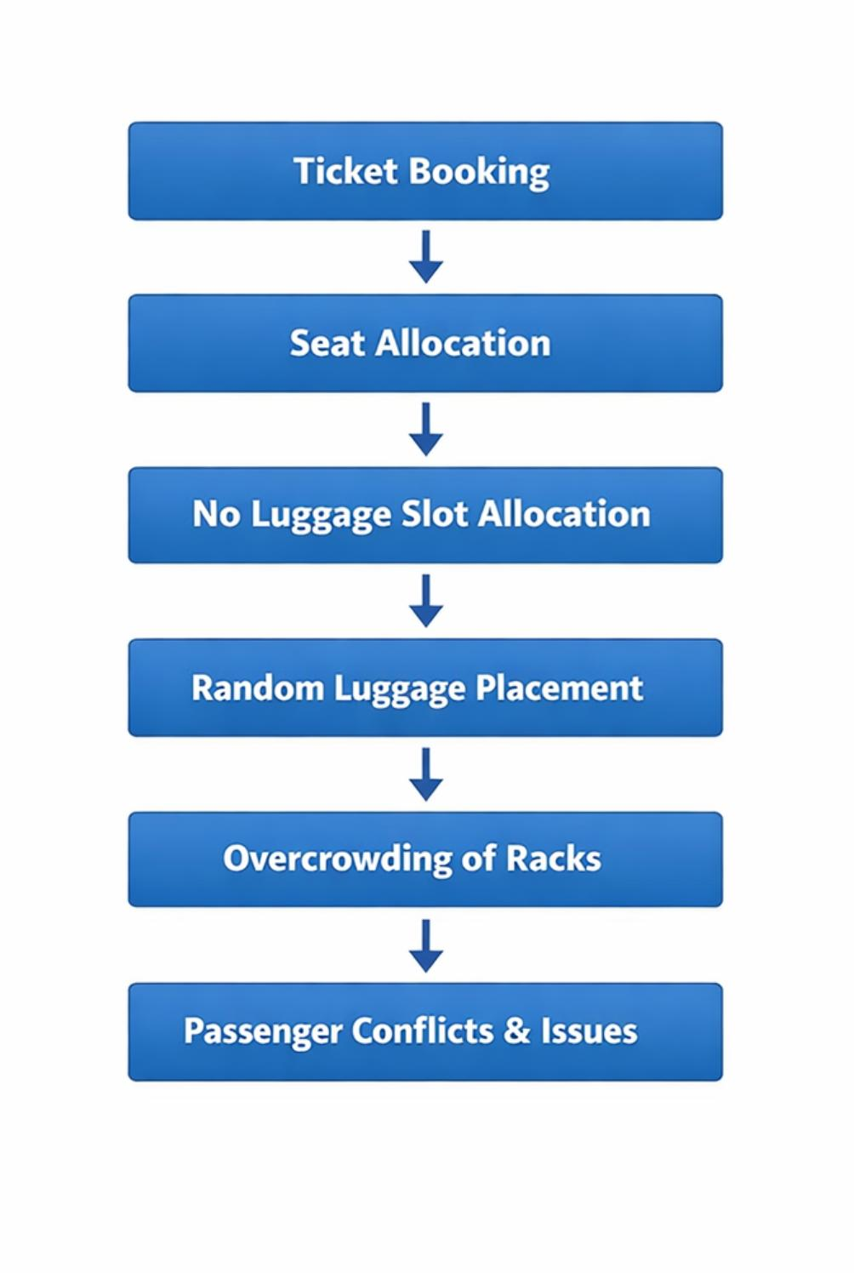
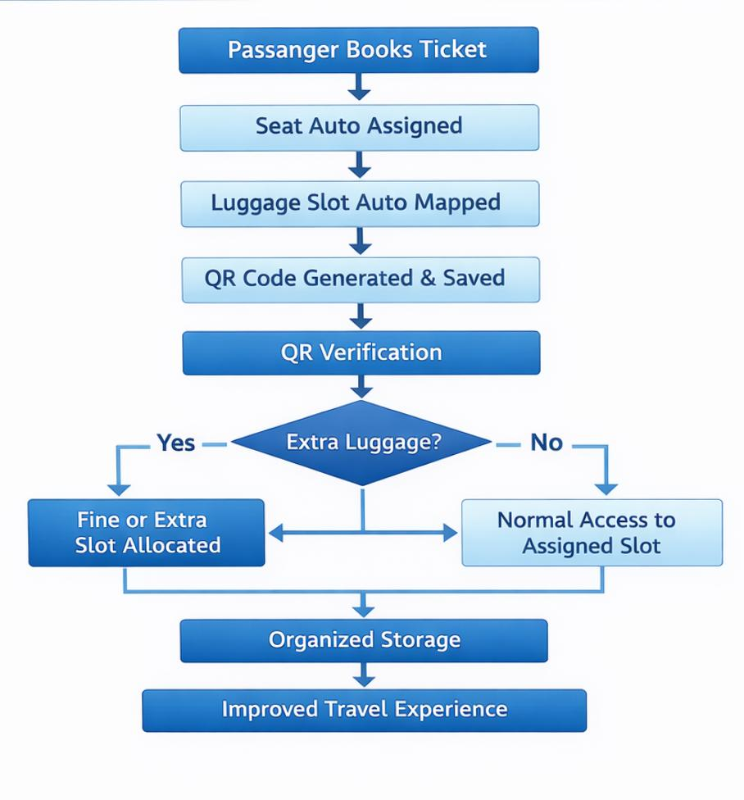
To-be process Diagram
As-Is process Diagram

Slide 5
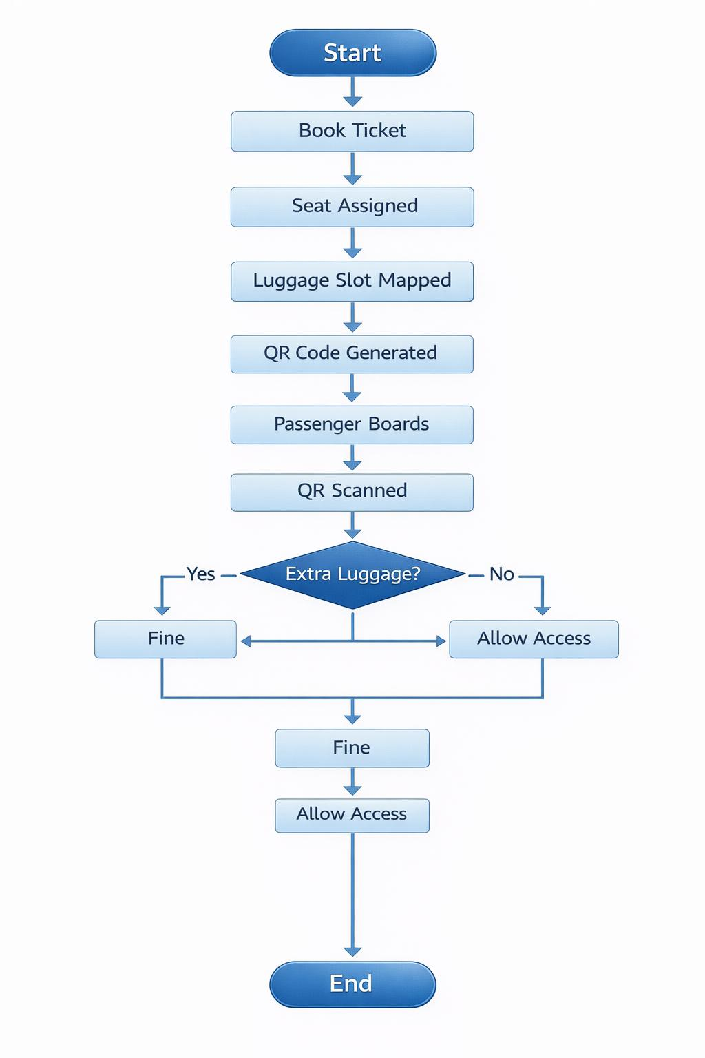
Flowchart

Slide 6
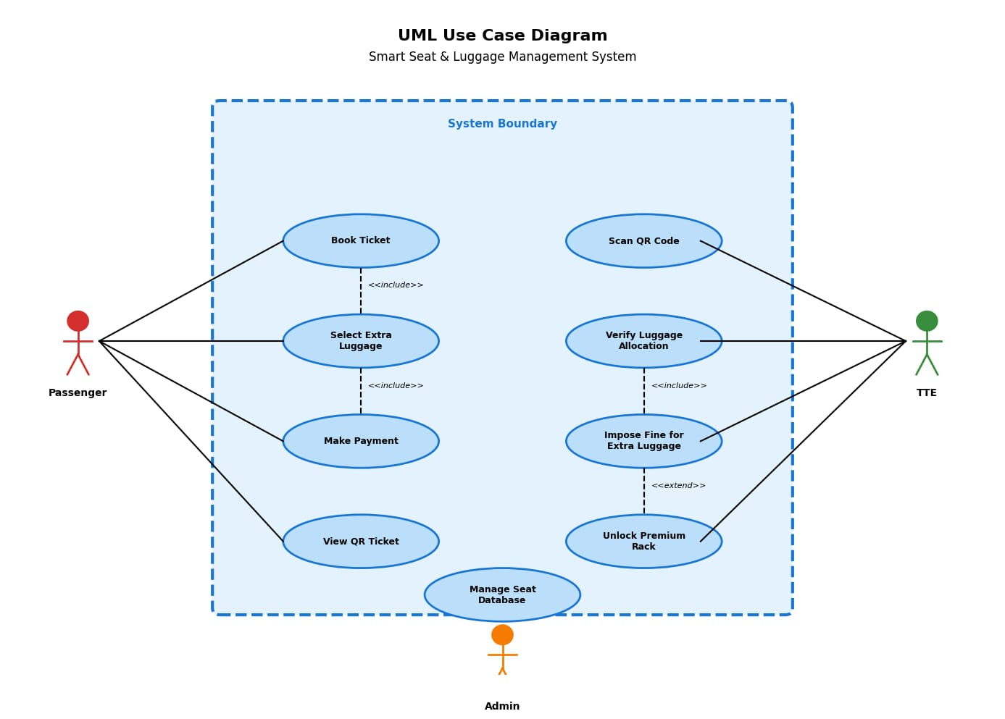
UML Diagrams
Use Case Diagram –

Slide 7
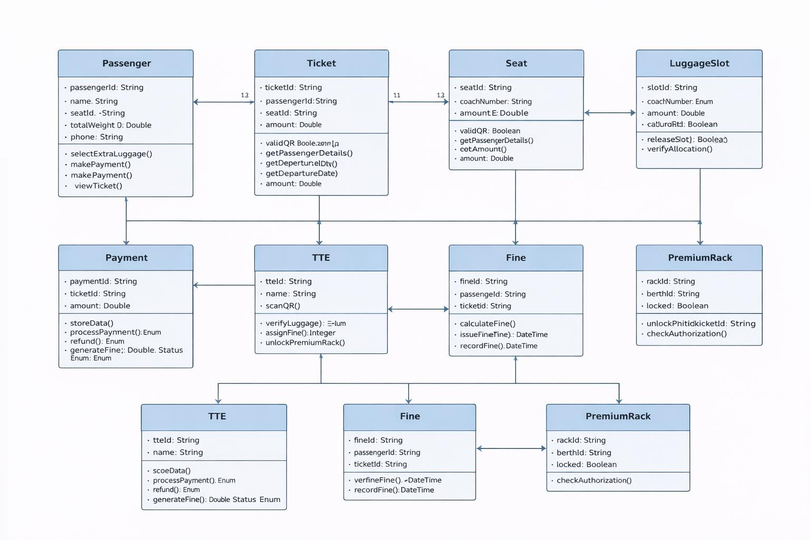
Use Class Diagram -

Slide 8
Data Safety
Encrypted before storage in a centralized secure database. Role-based access control ensures that only authorized staff and administrators can access or modify data. Digital fine payments are securely processed, and regular cloud backups prevent data loss. This ensures passenger privacy and system reliability.
Key Security Lines:-
Encrypted QR code data Secure centralized server Role-based authentication Digital payment security Cloud backup system

Slide 9
Innovation Aspect
The Smart Seat & Luggage Management System introduces a structured seat-to-luggage mapping mechanism, which is not present in current railway systems. It integrates QR-based verification, digital fine generation, and optional premium rack access into one unified platform. The system not only reduces passenger conflicts but also creates a new revenue model for railway.
Seat mapped to fixed luggage slot QR-based digital verification Automated fine system Pre-book extra luggage option Premium paid rack for additional revenue Scalable and future-ready design

Slide 10
Budget Control
The system is designed to minimize implementation cost by utilizing the existing railway digital booking infrastructure. Most components are software-based, reducing hardware dependency. Premium racks and smart locks can be introduced gradually through phased deployment, ensuring controlled investment and steady revenue recovery.
Budget Strategy:
Uses existing ticket booking system Software-focused implementation Minimal hardware cost Phased deployment model Revenue through extra luggage & fines

Slide 11
THANK YOU

